Slide 1


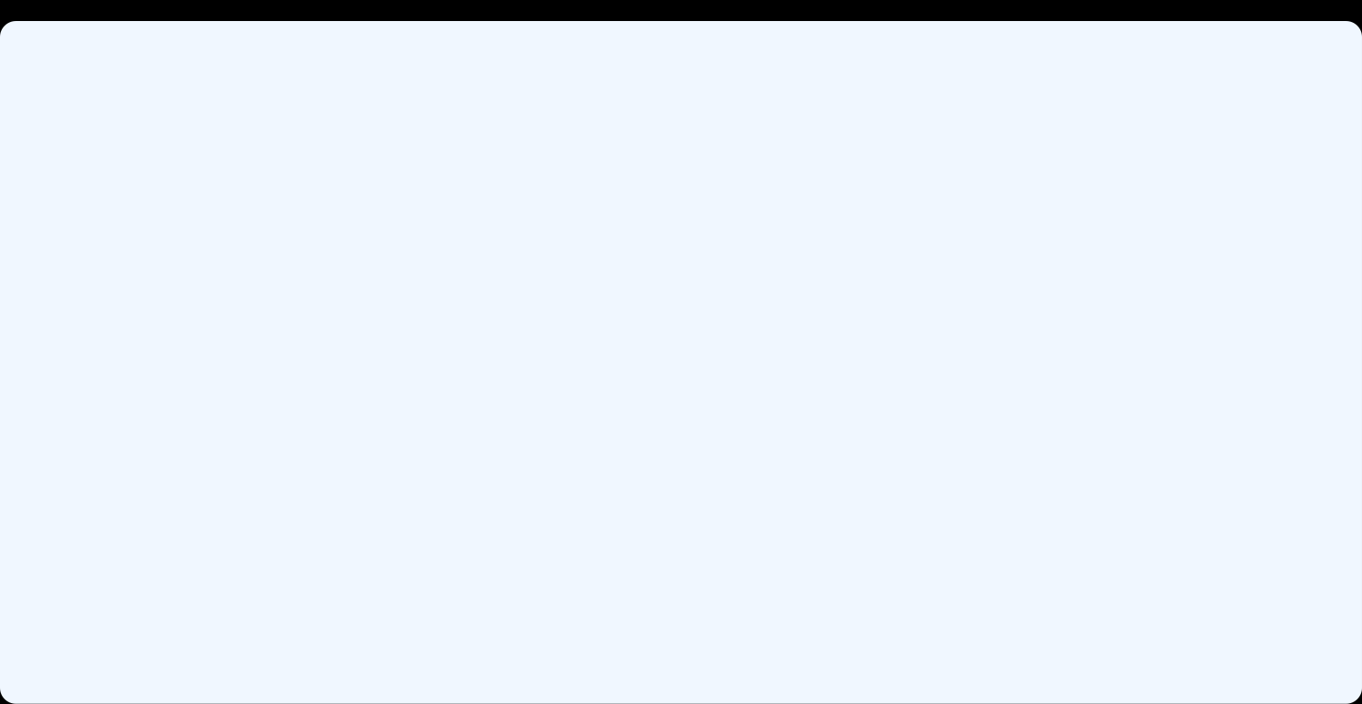


ELD411
Mid-Term Review — 2026
Autonomous robotic manipulator for AMR sampling (Petri Dish)
Arnav Panjla 2023EE10978
Manashvi Garg 2023EE11104

Slide 2
CONTENTS
Table of contents
01
Problem statement
02
Market analysis
Village sampling, and the lab bottleneck
Planning load, about 1200 dishes a day
03
Hardware iterations
04
Robotic arm and full-system CAD
Gantry rejected. SCARA too slow to build
6-DOF arm, cell layout, link changes
05
Compute platform
06
Gazebo simulation
Ubuntu first, then Raspberry Pi OS for the HAT
Arm motion beside the dish carousel
07
Vision
08
Progress and roadmap
Circles on the plate, then the antibiotic stamp
What is done, and what is left
IIT Delhi · ELD411 · Mid-Term Review 2026

Slide 3
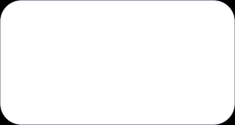
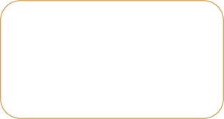

PROBLEM STATEMENT
02
The Challenge: Scaling AMR Surveillance
    Antimicrobial resistance (AMR) requires continuous surveillance.
    Rural/village-level sampling can generate many biological samples.
    Samples need to be collected, transported, incubated/processed and analyzed.
    Manual Petri-dish handling becomes a bottleneck as sample volume increases.
01
02
03
04
05
VILLAGES
COLLECTION
LAB
DISHES
BOTTLENECK
Distributed sampling
Repeated visits
Central processing
Handling + imaging
Manual repetition
OBJECTIVE
Repeated sampling creates high laboratory load.
Automate Petri-dish
handling + imaging
Dish transport, imaging and logging are repetitive.
Manual handling limits throughput and traceability.
IIT Delhi · ELD411 · Mid-Term Review 2026

Slide 4
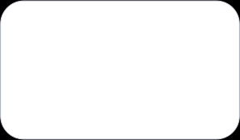




MARKET AND SCALE ANALYSIS
03
From Village Sampling to Laboratory Load
~3000
2–3%
60–90
4–5
5–6
people / village
sampling fraction*
(people that get sick and actually need testing)
samples / village
field collectors
villages / collector / day
DESIGN TARGET
ASSUMPTION
~1200
PETRI DISHES / DAY
Planning value for workflow, storage and robot duty cycle
IIT Delhi · ELD411 · Mid-Term Review 2026

Slide 5
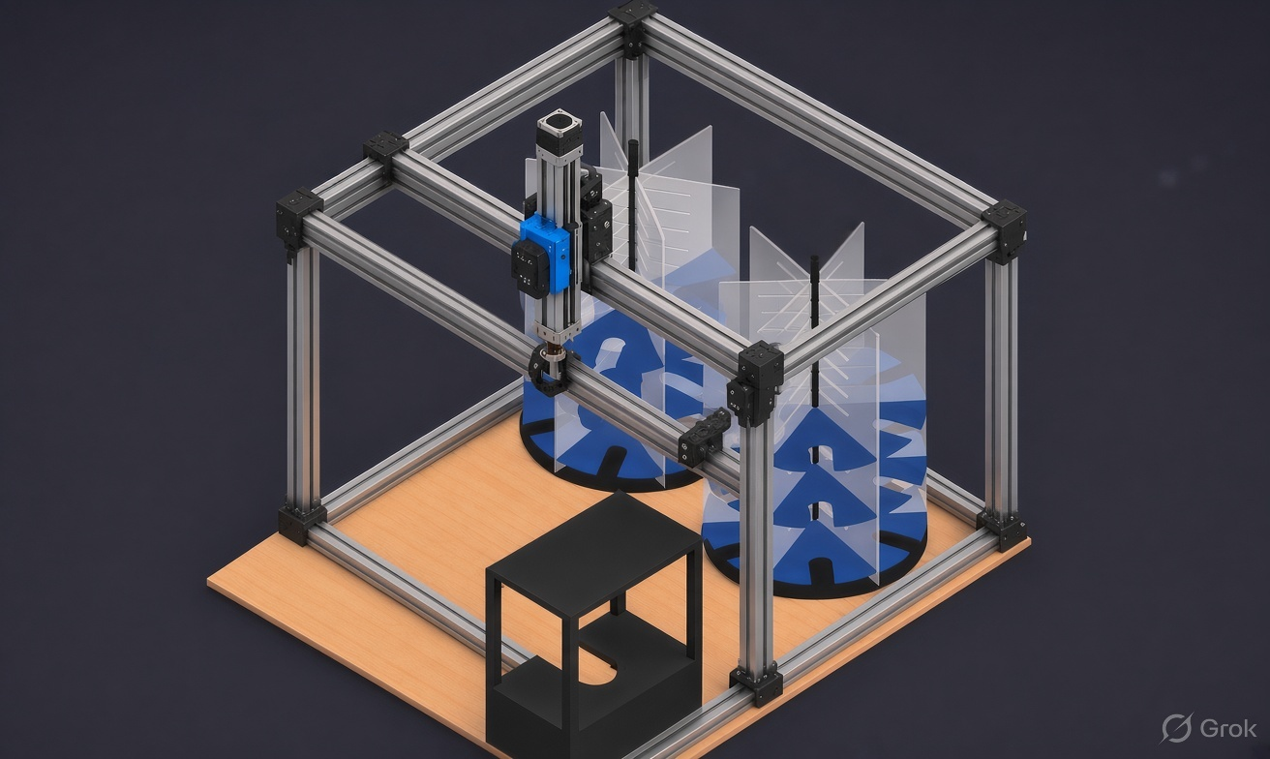
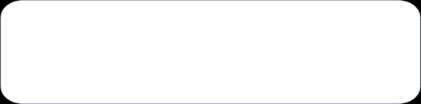
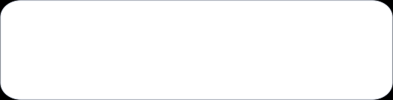

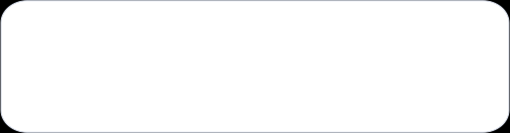
04
Iteration - I · 3D-printer / gantry frame
01
FULL XY GANTRY
Whole frame rides the gantry; nothing moves independently of it.
02
RESTRICTED REACH
Gripper travel is tied to the frame axis — cannot reach every individual dish slot at the carousel.
03
MATERIAL WASTE
Rails sized to the full base footprint even though only the carousel radius is used.
04
VERDICT: REJECTED
Frame motion, not the gripper, was the actual constraint. Scrapped before build.
IIT Delhi · ELD411 · Mid-Term Review 2026

Slide 6
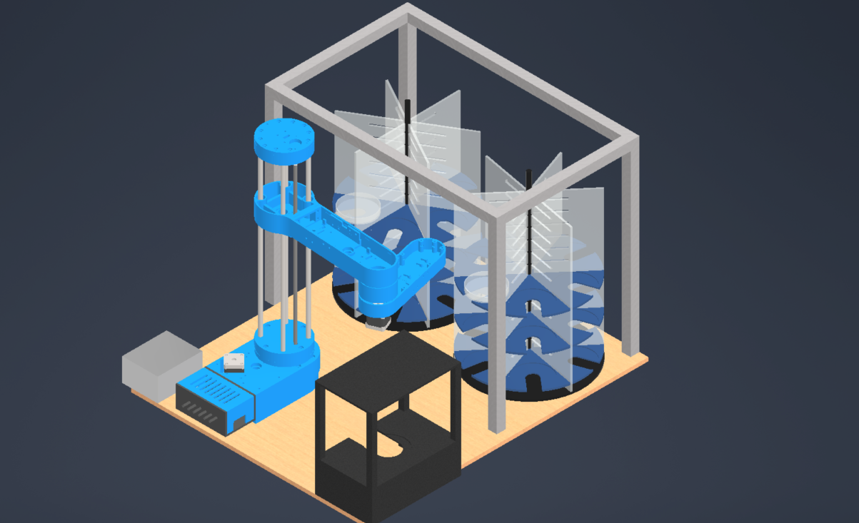
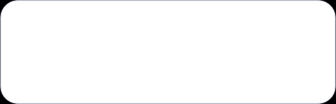

05
Iteration - II · SCARA arm
01
FULL WORKSPACE REACH
Arm swept the entire carousel; range of motion was exactly enough.
02
HARDER CONTROL MATH
Coupled joint angles replace simple XY moves — more complex than iteration I.
03
FULLY CUSTOM BUILD
Every link had to be designed and 3D-printed from zero — no off-the-shelf part fit.
04
VERDICT: TOO SLOW TO BUILD
Print-fit-reprint cycles on every joint made the build timeline the real blocker.
IIT Delhi · ELD411 · Mid-Term Review 2026

Slide 7

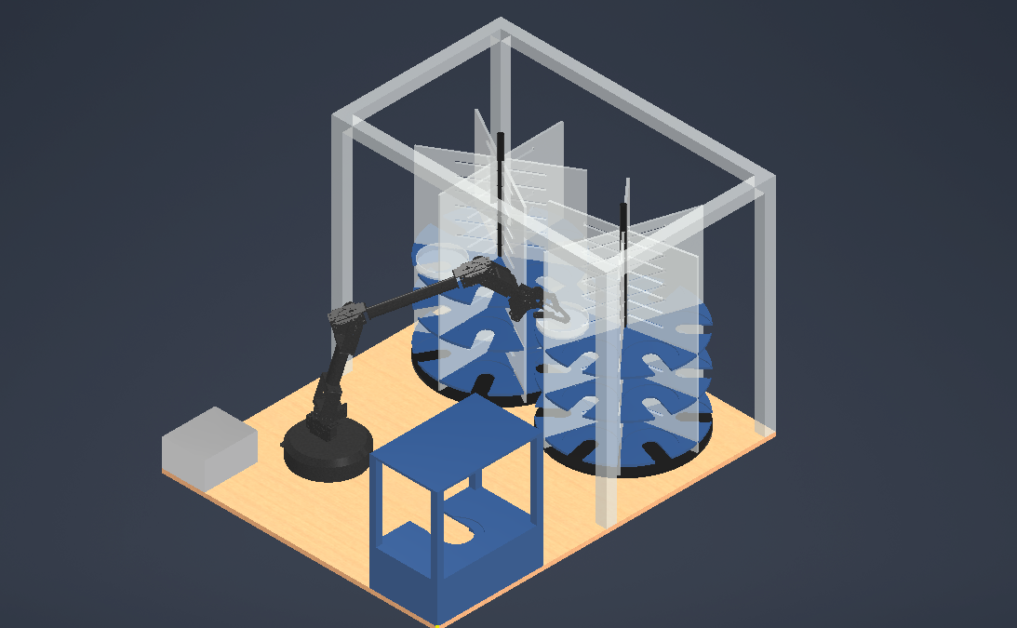
FULL-PROJECT LAYOUT
06
Final design · 6-DOF arm replaces the SCARA
1
Frame — aluminium extrusion cell
1
2
Carousel A — dish storage column
3
Carousel B — dish storage column
4
Robotic arm — 6-DOF (final swap-in)
2
3
5
Imaging station — staging table
6
Control box — drivers / electronics
4
7
Base plate — mounting deck
6
5
7
IIT Delhi · ELD411 · Mid-Term Review 2026

Slide 8
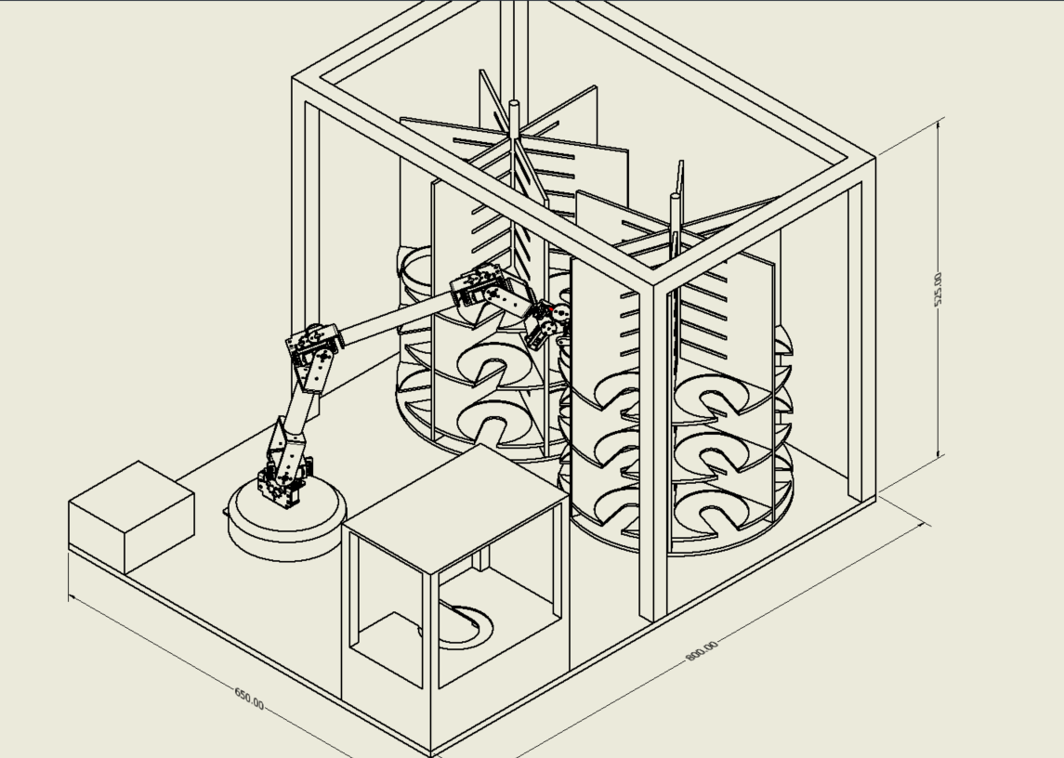
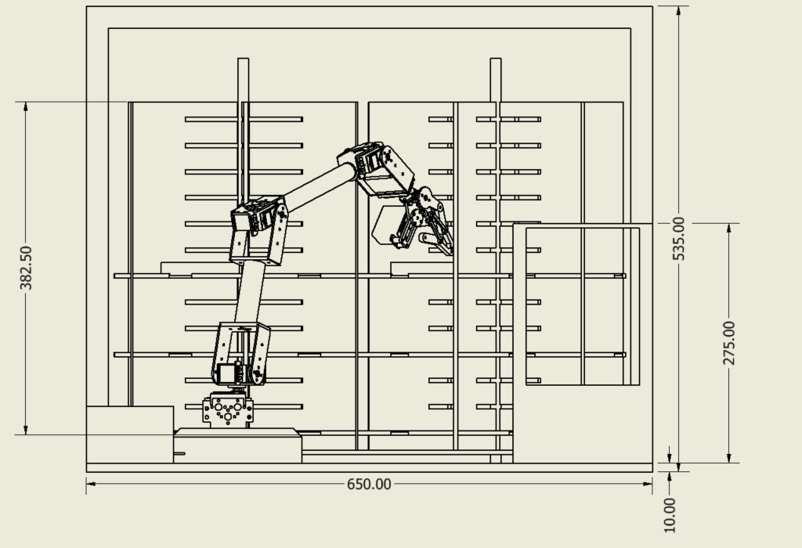
MANIPULATOR HARDWARE
07
6-DOF Robotic Arm
Elevation · reach check against carousel
Full assembly, dimensioned · 650 × 800 × 525 mm envelope
IIT Delhi · ELD411 · Mid-Term Review 2026

Slide 9
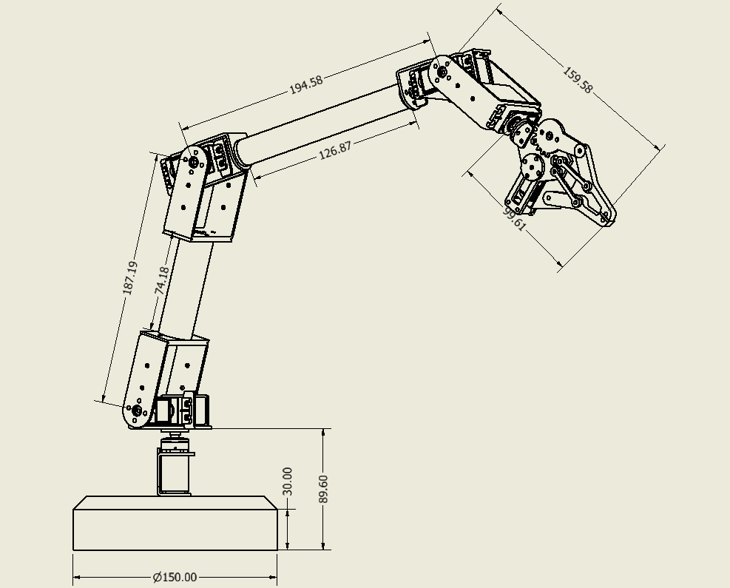
MECHANICAL ADAPTATION
08
Manipulator Modifications for Petri-Dish Reach
01
LONGER LINKS
Extend joints so the gripper clears the outer carousel ring
02
CAMERA MOUNT
Rigid mount above gripper, aligned with the QR scan axis (yet to decide)
03
CABLE ROUTING
Slack CSI + power routing so cables survive full joint travel
04
WIDER BASE
Widen 2 base-side links so reach stays even across the full carousel span.
IIT Delhi · ELD411 · Mid-Term Review 2026

Slide 10
COMPUTE PLATFORM
10
Raspberry Pi Setup
01
02
03
UBUNTU SERVER
CAMERA TEST
SWITCH TO RASPBERRY PI OS
First OS on the Pi. Chosen because ROS 2 install and packaging is easier on Ubuntu.
Camera Module verified working under Ubuntu Server before anything else was built.
Final OS. The add-on HAT board is only supported on Raspberry Pi OS, not Ubuntu.
WHY RASPBERRY PI OS WON
HAT compatibility decided it: the camera/control HAT ships drivers for Raspberry Pi OS only. Ubuntu stayed useful for early ROS 2 experiments, but the deployed board runs Raspberry Pi OS.
IIT Delhi · ELD411 · Mid-Term Review 2026

Slide 11
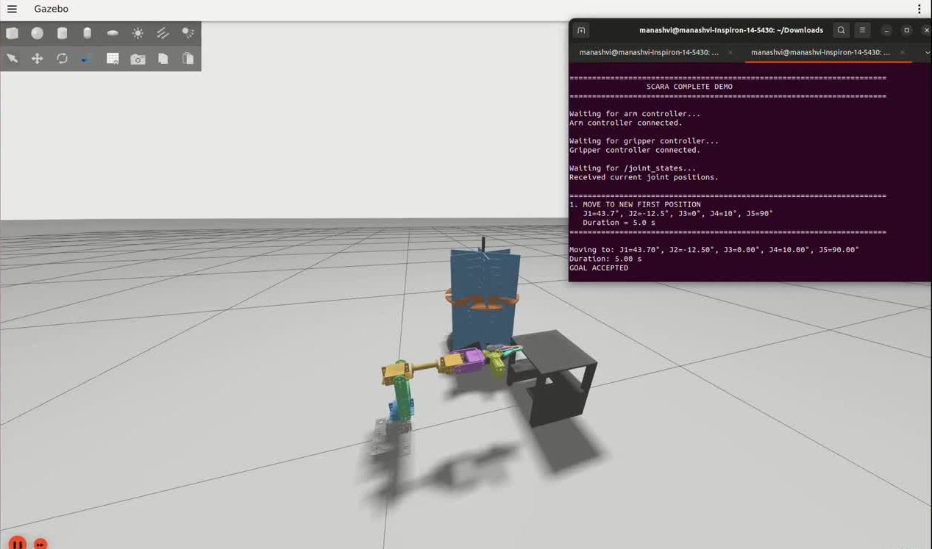
VALIDATION
11
Simulation Recording — Gazebo
IIT Delhi · ELD411 · Mid-Term Review 2026

Slide 12
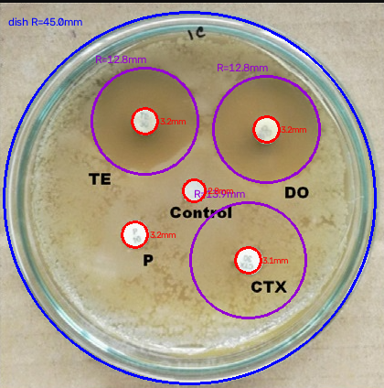
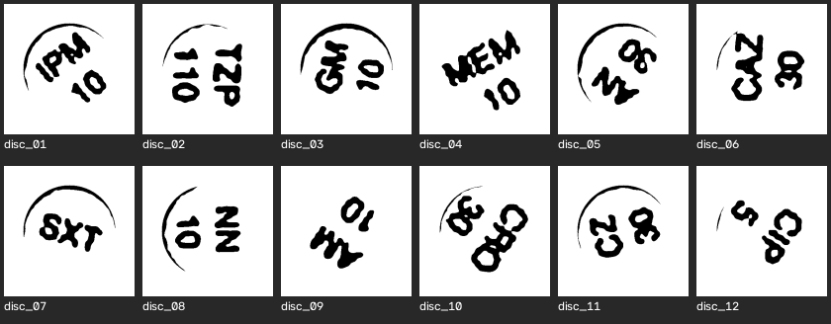
01
VISION
INNER DISK + OUTER ZONE
THE ANTIBIOTIC DISKS
Red = disk. Purple = inhibition zone. Blue = dish rim.
Each stamp is a second read. Circles do not give the code.
IIT Delhi · ELD411 · Mid-Term Review 2026
Notes:
cicle detection

Slide 13
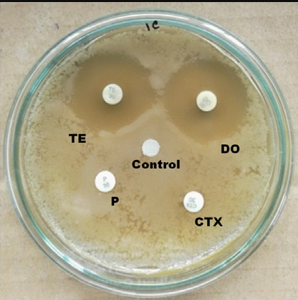
STEP 1 · CIRCLES
02
Before detection
INPUT
Raw plate. No circle is drawn yet.
cv2.cvtColor
BGR to gray
cv2.GaussianBlur
gray, (9, 9), 2
Blur is only here so speckle does not become a circle.
IIT Delhi · ELD411 · Mid-Term Review 2026
Notes:
low pass = gaussian blur
edge shrapening = canny filter
clahe =
morphology
brightness contrast

Slide 14
STEP 1 · CIRCLES
03
After detection
01 DISH RIM
cv2.HoughCircles
HOUGH_GRADIENT
Largest circle. Blue.
02 INNER DISK
HoughCircles again
radius 1.6–4.5 mm
Brightness gate. Red.
03 OUTER ZONE
Radial profile
Not Hough
Gray step around the disk. Purple.
IIT Delhi · ELD411 · Mid-Term Review 2026

Slide 15


STEP 2 · STAMP
04
Low-pass · Gaussian blur
cv2.GaussianBlur(gray, (15, 15), 4)
BEFORE
AFTER · GAUSSIAN BLUR
Low-pass. Agar grain and sensor noise become false edges if they reach Canny or Hough. The plate detector uses the same call at (9, 9), σ = 2.
IIT Delhi · ELD411 · Mid-Term Review 2026

Slide 16
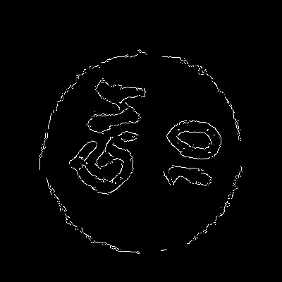
STEP 2 · STAMP
05
Edges · Canny
cv2.Canny(gray, 20, 60)
BEFORE
AFTER · CANNY
Canny edge detector: Sobel gradient, non-maximum suppression, hysteresis. It returns an edge map, not a character. Thresholds 60 / 160 drop these soft strokes.
IIT Delhi · ELD411 · Mid-Term Review 2026

Slide 17
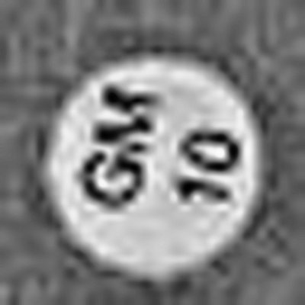
STEP 2 · STAMP
06
Local contrast · CLAHE
cv2.createCLAHE(clipLimit=2.0, tileGridSize=(8, 8)).apply(gray)
BEFORE
AFTER · CLAHE
Contrast-limited adaptive histogram equalization. Lifts stamp-versus-paper contrast inside small tiles without blowing the whole crop.
IIT Delhi · ELD411 · Mid-Term Review 2026

Slide 18
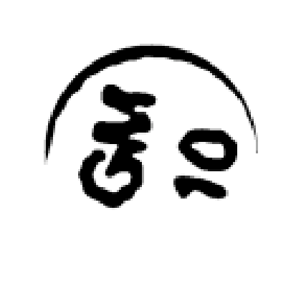

STEP 2 · STAMP
07
Morphology · opening
ker = cv2.getStructuringElement(cv2.MORPH_ELLIPSE, (7, 7)); cv2.morphologyEx(ink, cv2.MORPH_OPEN, ker, iterations=1)
BEFORE · OTSU
AFTER · MORPH OPEN
Opening is erosion, then dilation. Thin arcs break. Thick strokes stay. The binary input is Otsu: cv2.threshold(..., THRESH_OTSU). Still not a string.
IIT Delhi · ELD411 · Mid-Term Review 2026

Slide 19
STEP 2 · STAMP
09
Filters were not the reader
TRADITIONAL PATH
GEMMA 3 4B
Another image.
Never the code.
Reads the disk
in one call.
Gaussian blur — smoother pixels
Local model, gemma3:4b.
No hand-built filter chain on the stamp.
The model does the filtering and the read.
Canny — an edge map
CLAHE — local contrast
Morphology — thinner strokes
convertScaleAbs — brighter paper
Hough still finds the circles first.
Gemma does not replace that step.
IIT Delhi · ELD411 · Mid-Term Review 2026

Slide 20
DECISION LEFT OPEN
10
Two readers, one circle step
LOWER COMPUTE
HIGHER COMPUTE
Traditional filters
Gemma 3 4B
Gaussian, CLAHE, Canny, morphology, brightness / contrast, then an OCR engine.
One local vision-language call on the disk crop. Filtering and reading happen inside the model.
Fits the Raspberry Pi.
No large model.
Did not read these rotated stamps.
Heavier than the Pi filter path.
12 / 12 on the upright test1.png crops.
Kept, not locked in.
IIT Delhi · ELD411 · Mid-Term Review 2026

Slide 21
NATIVE GEMMA + RIM STRIP
10
12 / 12 on this plate only
TEST1
01
02
03
12/12
IPM 10
TZP 110
GM 10
04
05
06
MEM 10
AN 30
CAZ 30
Eye-read ground truth.
n = 12 is not clinical accuracy.
07
08
09
SXT
NN 10
AM 10
Offline after
ollama pull gemma3:4b
10
11
12
CRO 30
CZ 30
CIP 5
IIT Delhi · ELD411 · Mid-Term Review 2026

Slide 22
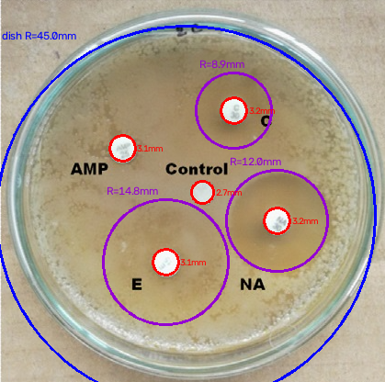
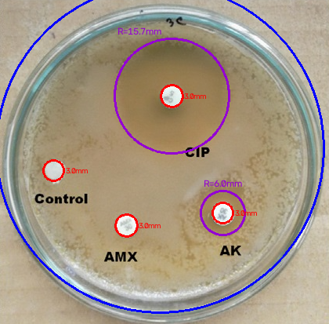
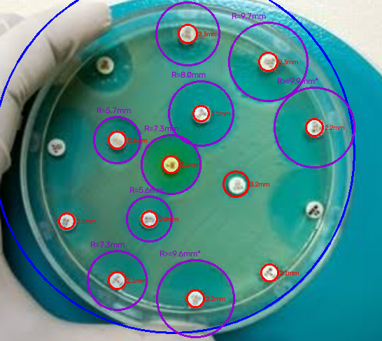
STEP 1 · CIRCLES
11
Same detector, other plates
s2 · AMP, E, NA
s3 · CIP, AMX, AK
s5 · denser plate
IIT Delhi · ELD411 · Mid-Term Review 2026

Slide 23
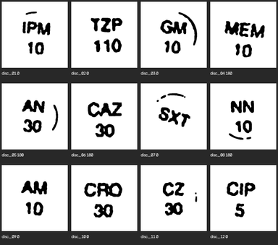
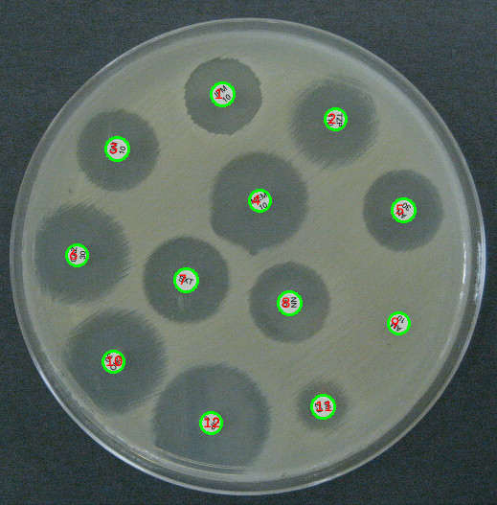
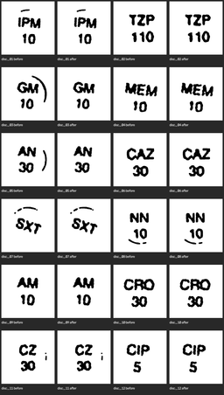
STEP 2 · STAMP
12
Images in front of the reader
Upright stamps · letters above, digits below
test1 · Hough disks
Rim ink stripped · before / after, all 12 disks
IIT Delhi · ELD411 · Mid-Term Review 2026

Slide 24
Current Progress & Roadmap
MID-TERM STATUS
NEXT PHASE ROADMAP
Problem & system definition
COMPLETED
01
Finalize manipulator
Procurement + end-effector integration
Hardware architecture
COMPLETED
Complete perception
02
Dish localization + feature detection
Raspberry Pi + camera
COMPLETED
03
Implement robot control
Computer vision pipeline
IN PROGRESS
ESP32 / Zephyr + motor interface
04
Validate in Gazebo
ESP32 + Zephyr RTOS
IN PROGRESS
ROS 2 + trajectories + pick/place
Manipulator procurement
IN PROGRESS
05
System integration
Vision → coordinates → manipulation
Gazebo simulation
IN PROGRESS
Throughput testing
06
Target: ~100 dishes/day
Autonomous pick & place
UPCOMING
Notes:
+ market analyis
+ Hardware testing
+ failed iterations
+

Slide 25

THANK YOU

Slide 26
